Slide 2
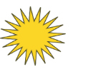










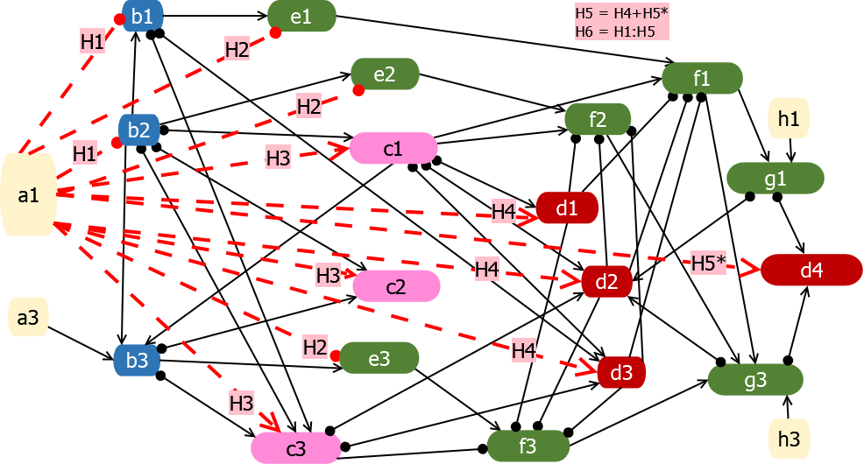
Temperature Hypotheses
H1
Prey
−
−
H2
Condition
−
−
−
−
−
H3
Competitors
−
−
+
+
+
H4
Juvenile Predators
−
−
+
+
+
H5
All Predators
−
−
+
+
+
+
−
−
−
−
−
+
H6
All
+
+
+
+
+
+
Notes:
Figure 2. Network diagram showing direct temperature impacts of climate variable 1 (a1) on functional groups in addition to the primary bottom-up pathway (see Figure 1). The specific links are listed in Table S1.2. H8*indicates that this node is added to other predator nodes in the full H8 hypothesis. [NOTE, I want to make sure the process of considering each temperature link is really clear from figures, not just text, but I am exploring different ways to do that besides this figure, hence the duplicate text in Fig 1. Fig 1 is a prettier presentation, but I, for one, can tell where any of the lines are going]

Slide 3





















Base food web Alternate food web
(a) Alternative prey
(b) Size-selective
Bird predation
(c) Fish predators 1:
Reduced competition
(d) Fish predators 2:
Reduced predation
(e) Mammal benefit (arrows) removed
Added
Removed or changed sign
Unchanged

Slide 4
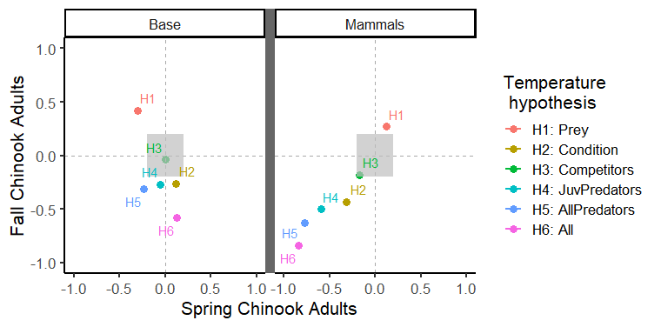

Slide 5
(a)
Food web
(b)
Temperature hypothesis

Slide 6
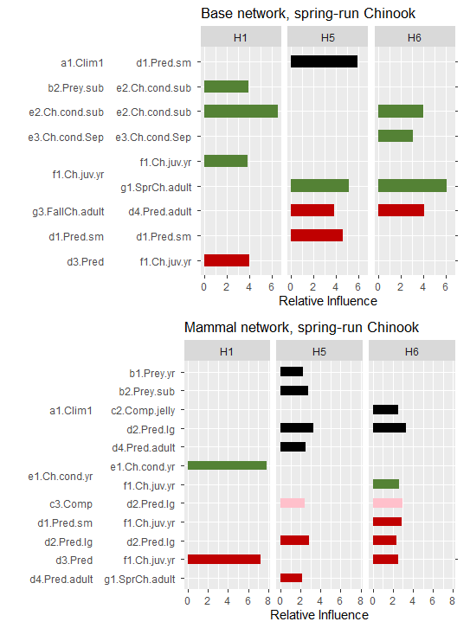
Link:
From
To
Climate
Salmon
Predator
Climate
Salmon
Competitor
Predator

Slide 7
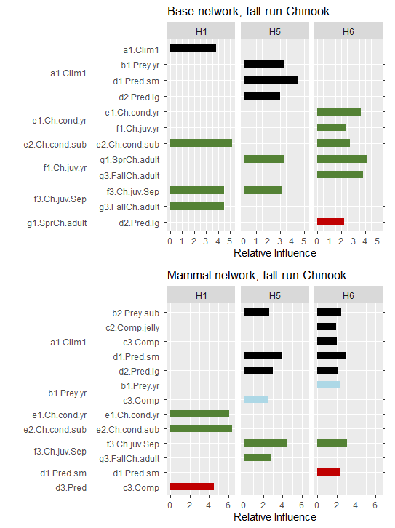
Link:
From
To
Climate
Salmon
Predator
Climate
Prey/
Competitor
Salmon
Predator

Slide 8
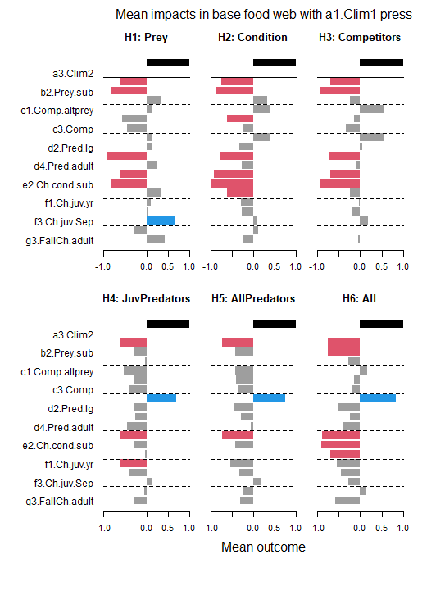
a)
14

Slide 9
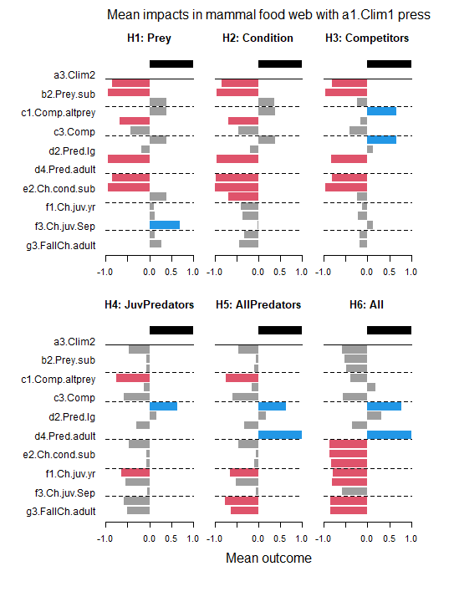
b)
Figure S2.1. Outcomes of climate press on base and mammal networks for all nodes
Bar charts show the mean outcomes for each functional group in (a) the base and (b) the mammal network simulations after a climate perturbation, under each temperature hypothesis. The black bars represent the climate perturbation. Red bars indicate a consistently negative response, while blue bars indicate a consistently positive response. Gray bars represent either weakly signed or neutral responses (-0.6 to 0.6). The solid line highlights the climate perturbation that was applied, while dashed lines are for readability purposes. For descriptions of each hypothesis, refer to Figure 2.
15

